Slide 1

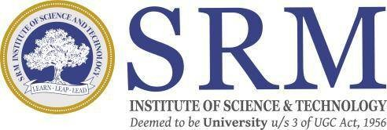
Evaluating a Multi-Agent Intelligent Compliance Auditor (MAICA) for Automating AI Regulation Adherence Compared to Traditional Manual Compliance Methods in Ensuring Ethical and Secure AI Deployments
SRM INSTITUTE OF SCIENCE AND TECHNOLOGY
SCHOOL OF COMPUTING
DEPARTMENT OF COMPUTING TECHNOLOGIES
21CSP302L - MINOR PROJECT
Guide name: Dr. S. Ashwini
Designation: Assistant Professor Department: Computing Technologies
Batch ID: 837
Student 1 Reg. No: RA2311003010147
Student 1 Name: Pooja Ellanti
Student 2 Reg. No: RA2311003011023
Student 2 Name: Adhira Srikanth

Slide 2
Problem Statement
Problem Background:
AI systems in healthcare and finance are commonly evaluated only based on predictive accuracy.
However:
Fairness is often ignored.
Security vulnerabilities are overlooked.
Explainability is missing.
Regulatory compliance is rarely verified systematically.
Need for the Study:
There is no unified automated system that:
Audits AI models for fairness, security, and compliance.
Compares automated results with manual auditing.
Provides structured governance reporting.
Offers real-time audit execution through a web interface.
Hence, there is a need for a multi-agent AI compliance auditing framework.

Slide 3
Objectives
Objective 1
Design and implement a multi-agent AI compliance auditing framework (MAICA).
Objective 2
Automate security, fairness, explainability, and regulatory checks.
Objective 3
Compare automated auditing results with traditional manual auditing.
Objective 4 (Upcoming Enhancement)
Integrate MAICA into a real Healthcare / Finance AI application as a governance middleware layer for real-time compliance validation.

Slide 4
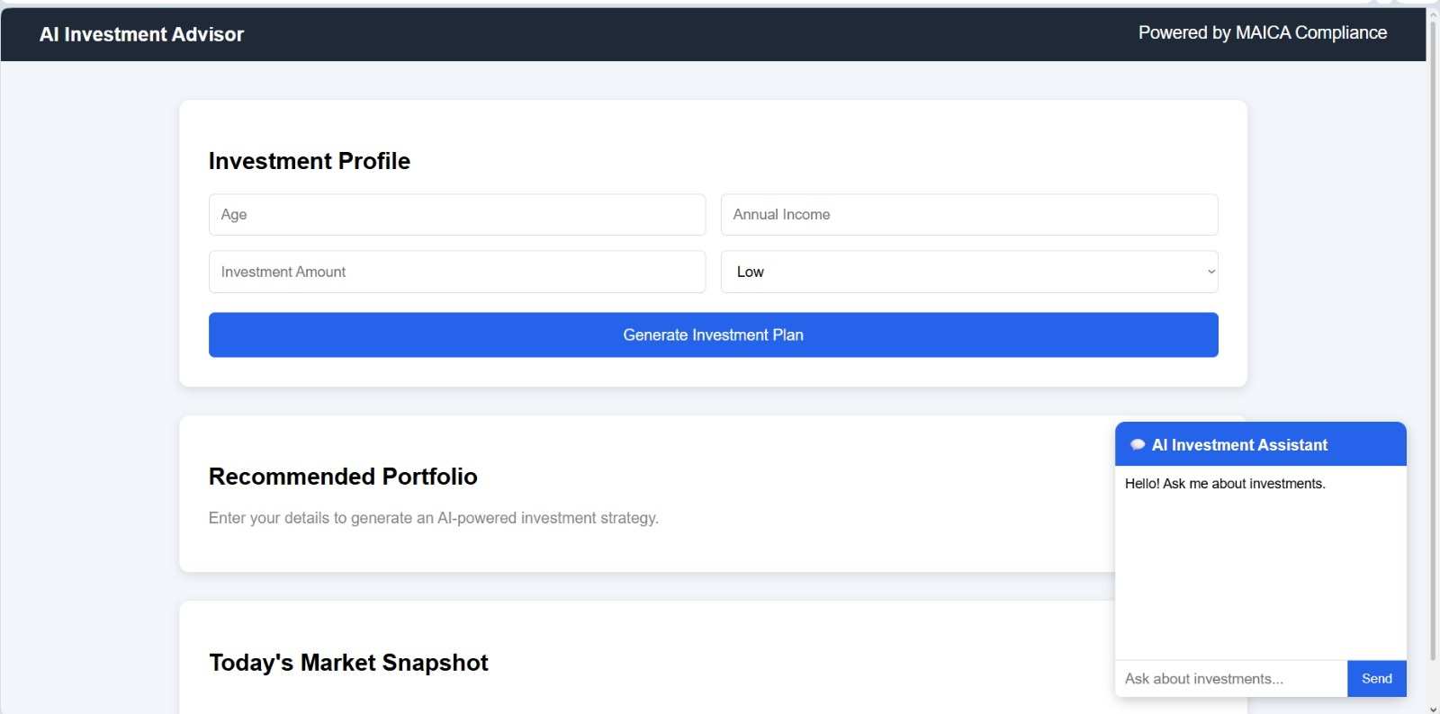
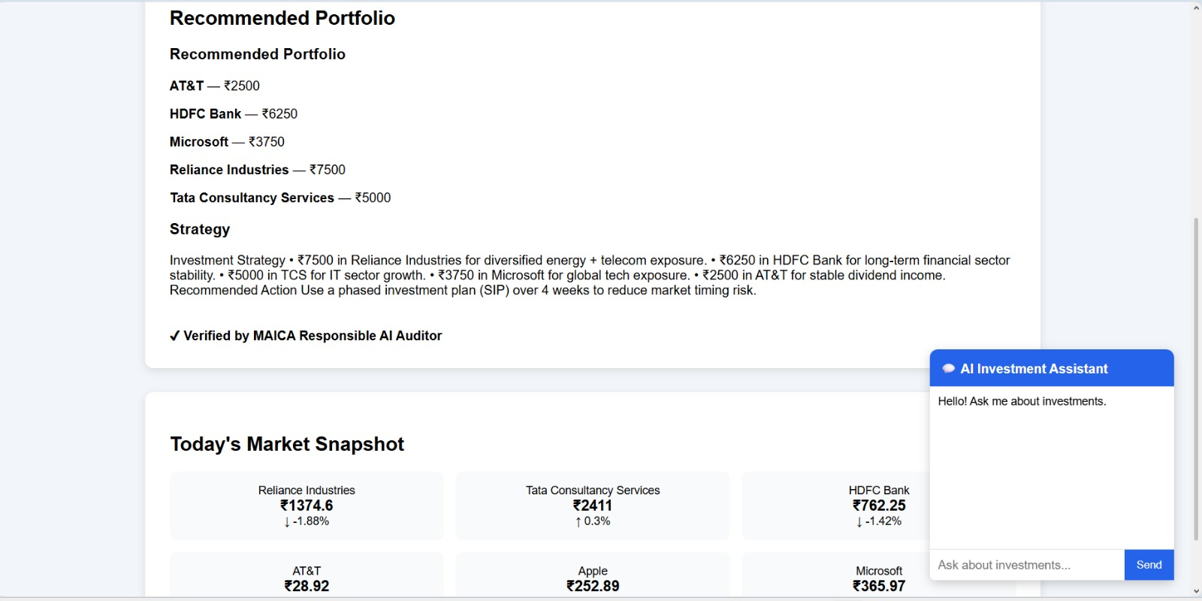
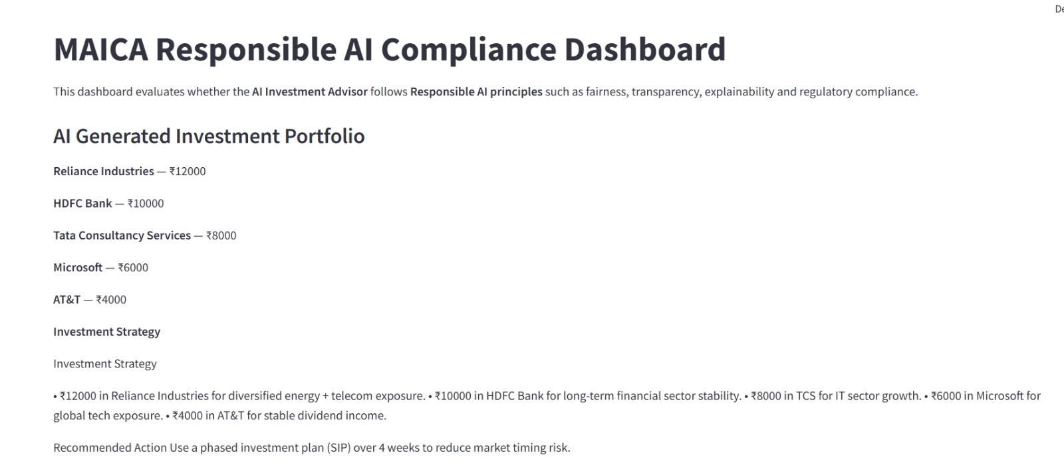
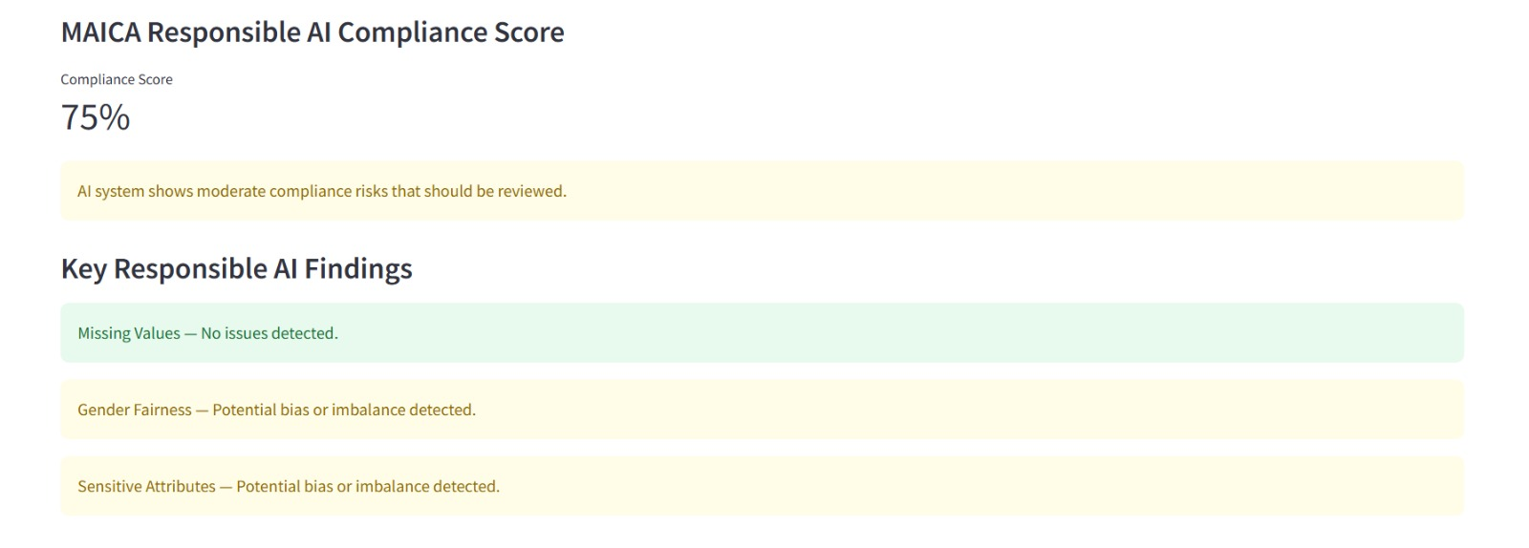
Objectives

Slide 5
Literature Review
Author & Year | Title | Contribution | Identified Gap
Phiri (2025) | Creating Characteristically Auditable Agentic AI Systems (ACM) | Defines theoretical foundations for auditability-by-design in multi-agent systems. | Lacks practical implementation or comparative evaluation vs. manual auditing.
Marino et al. (2024) | Automating EU AI Act Compliance Analyses | Proposed regulatory parsing models for automated AI compliance checks. | Limited to rule translation, no runtime monitoring or explainability integration.
Agarwal et al. (2025) | Multi-Agent Knowledge Graph for Regulatory QA | Introduced multi-agent QA system for interpreting legal rules. | No empirical comparison or auditing metrics.
Manheim (2025) | AI Audit Standards Boards (Springer) | Advocates for formal AI auditing standards. | No implementation model for automation or intelligent agents.
Gap Identified: Existing works focus on conceptual frameworks or rule parsing for compliance but lack a comprehensive, multi-agent auditing system capable of performing end-to-end automated audits, providing explainability, and offering quantitative comparisons with manual auditing processes.

Slide 6
Proposed Methodology
System Architecture
MAICA consists of the following agents:
• Regulation Ingestion Agent – Converts policies into machine-readable rules • Security Agent – Detects sensitive attributes and vulnerabilities • Data Protection Agent – Ensures privacy compliance • Model Inspection Agent – Evaluates fairness and bias • Runtime Monitoring Agent – Observes deployed model behavior • Explainability Agent – Generates SHAP/LIME explanations • Coordinator Agent – Aggregates results and generates compliance reports
Tools & Technologies
Python
scikit-learn (Logistic Regression)
SHAP / LIME
Pandas / NumPy
Streamlit (Current UI)
Flask/FastAPI (Next Step Web Deployment)
JSON / CSV Reporting

Slide 7
Proposed Methodology
Implementation:
• Multi-agent backend fully implemented • Compliance reports generated in JSON/CSV • Manual vs Automated comparison module • Streamlit-based domain selection dashboard
• Developed a standalone Healthcare / Finance AI application • Embed MAICA as compliance middleware • Enabled prediction + compliance audit execution in parallel • Displayed compliance score alongside prediction results
This transitions MAICA from a research prototype to an embedded AI governance framework.

Slide 8
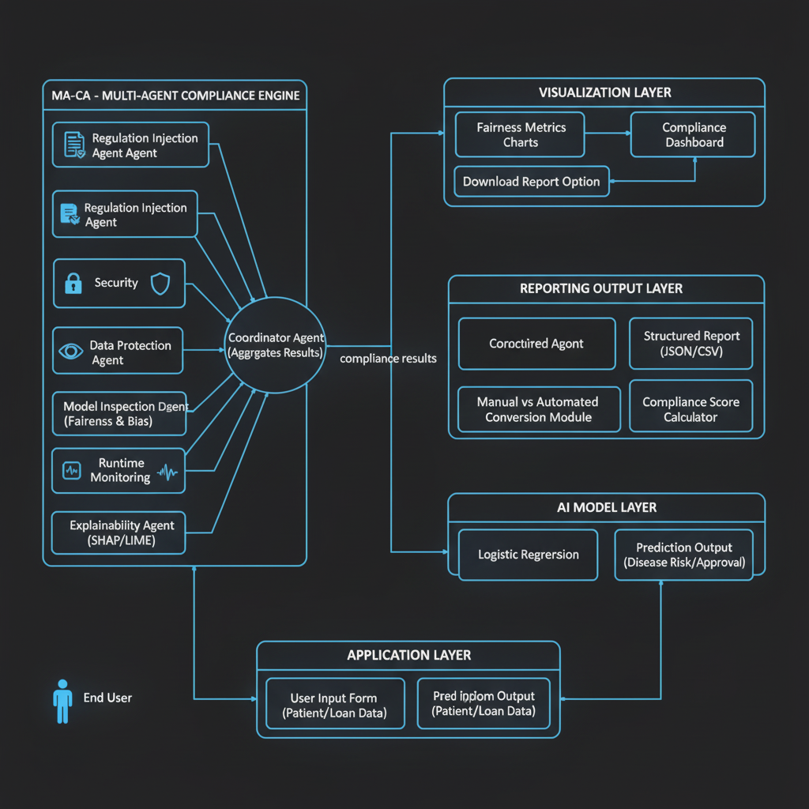
Proposed Methodology

Slide 9
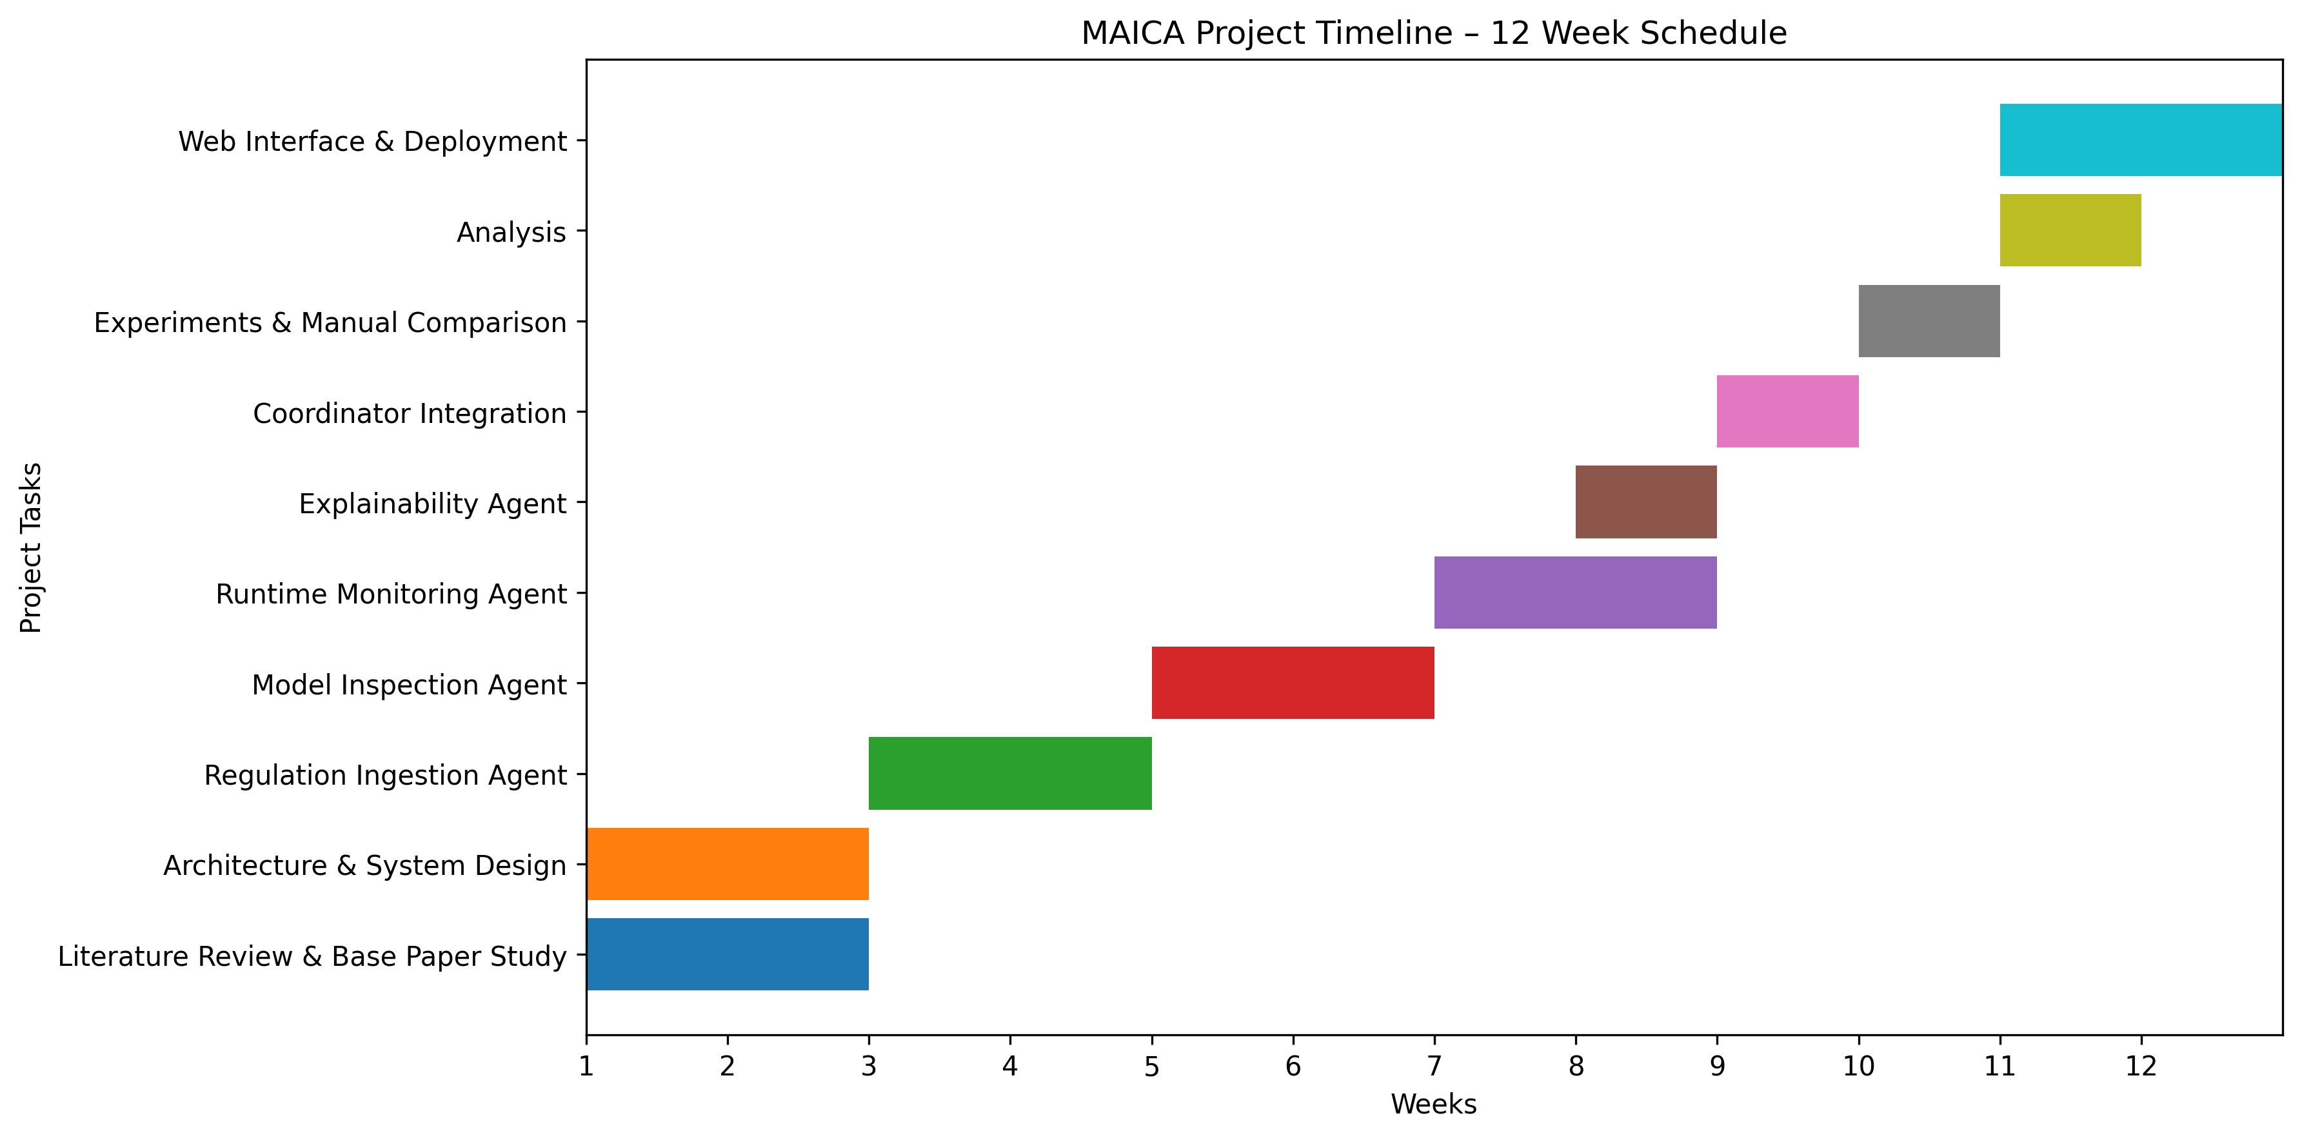
Work Plan / Timeline
Phase 1 – Completed
✔ Problem Identification ✔ Literature Review ✔ Dataset Selection ✔ Model Training ✔ Multi-Agent Development ✔ Compliance Report Generation ✔ Manual vs Automated Comparison ✔ Streamlit Dashboard
Phase 2 – Completed
✔ Refining fairness metric computation ✔ Enhancing compliance scoring system ✔ Improving explainability visualization
Phase 3 – Completed
✔ Develop Finance AI application ✔ Integrate MAICA as governance middleware ✔ Enable real-time compliance auditing ✔ Validate integrated system performance

Slide 10
Expected Outcome
Product Output
Fully functional Multi-Agent AI Compliance Platform
Automated compliance score generation
Manual vs Automated comparison system
Structured regulatory compliance reporting
Integrated AI Application with Embedded Governance Layer
SDG Mapping
Aligned with SDG 9 – Industry, Innovation and Infrastructure
Promotes responsible AI innovation
Strengthens digital governance infrastructure
Encourages sustainable AI deployment

Slide 11
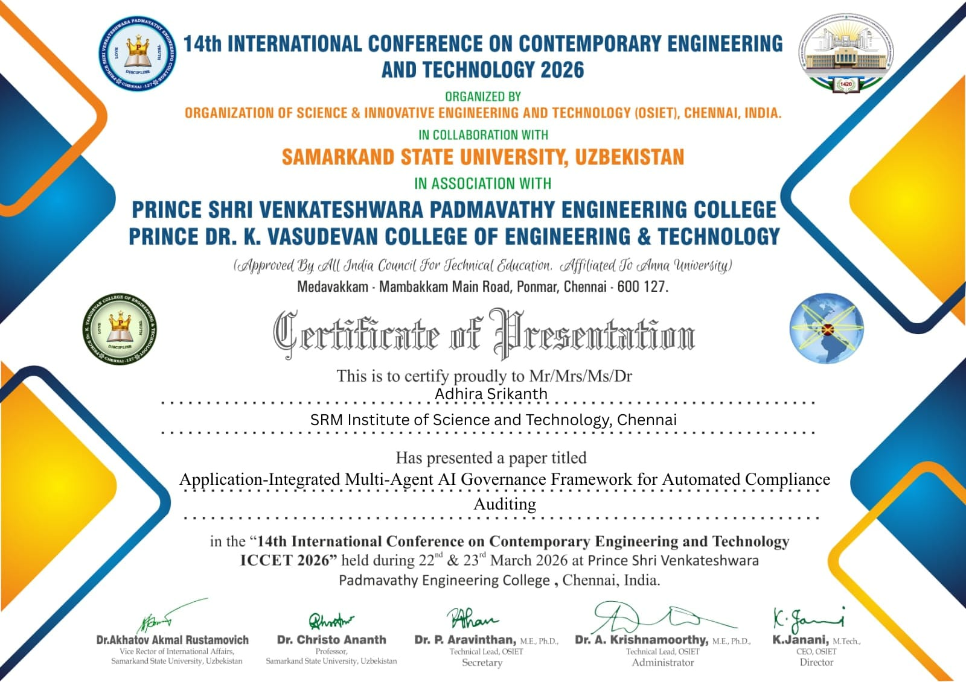

Expected Outcome
Publication Plan
Possible research paper on: “Application-Integrated Multi-Agent AI Governance Framework for Automated Compliance Auditing”

Slide 12
Conclusion
MAICA provides:
Automated multi-dimensional AI auditing
Integration of security, fairness, and explainability checks
Structured compliance reporting
Manual vs automated audit comparison
Transition toward a web-based governance platform
Future Scope:
Real-time monitoring integration
Cloud deployment
Regulatory knowledge graph integration
Enterprise-level scalability

Slide 13
References
Phiri, C.C. (2025). Creating Characteristically Auditable Agentic AI Systems. ACM IntRob ’25, Budapest, Hungary. DOI: 10.1145/3759355.3759356
Marino, B. et al. (2024). Automating EU AI Act Compliance Analyses. arXiv preprint arXiv:2406.14243
Agarwal, B. et al. (2025). A Multi-Agent Knowledge Graph for Regulatory QA. arXiv preprint arXiv:2501.18765
Manheim, D. (2025). The Necessity of AI Audit Standards Boards. AI & Society, Springer.
AuditMAI Project (2024). Towards Continuous AI Auditing Infrastructure.

Slide 14
THANK YOU

